Slide 1
5
APPLICATIONS OF INTEGRATION
Copyright © Cengage Learning. All rights reserved.

Slide 2
5.1
Areas between Curves
Copyright © Cengage Learning. All rights reserved.

Slide 3
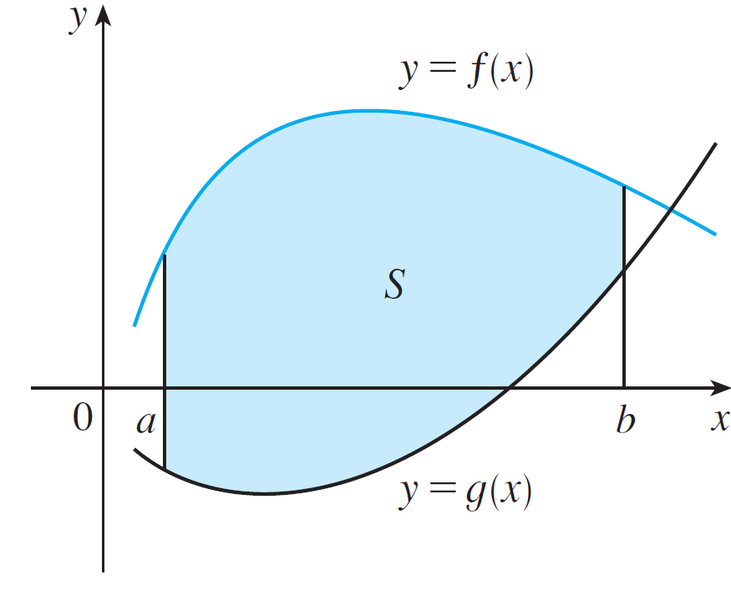
Areas between Curves
We use integrals to find areas of regions that lie between the graphs of two functions.
Consider the region S that lies
between two curves y = f (x) and
y = g (x) and between the vertical
lines x = a and x = b, where f and
g are continuous functions and
f (x) ≥ g (x) for all x in [a, b].
(See Figure 1.)
Figure 1

Slide 4


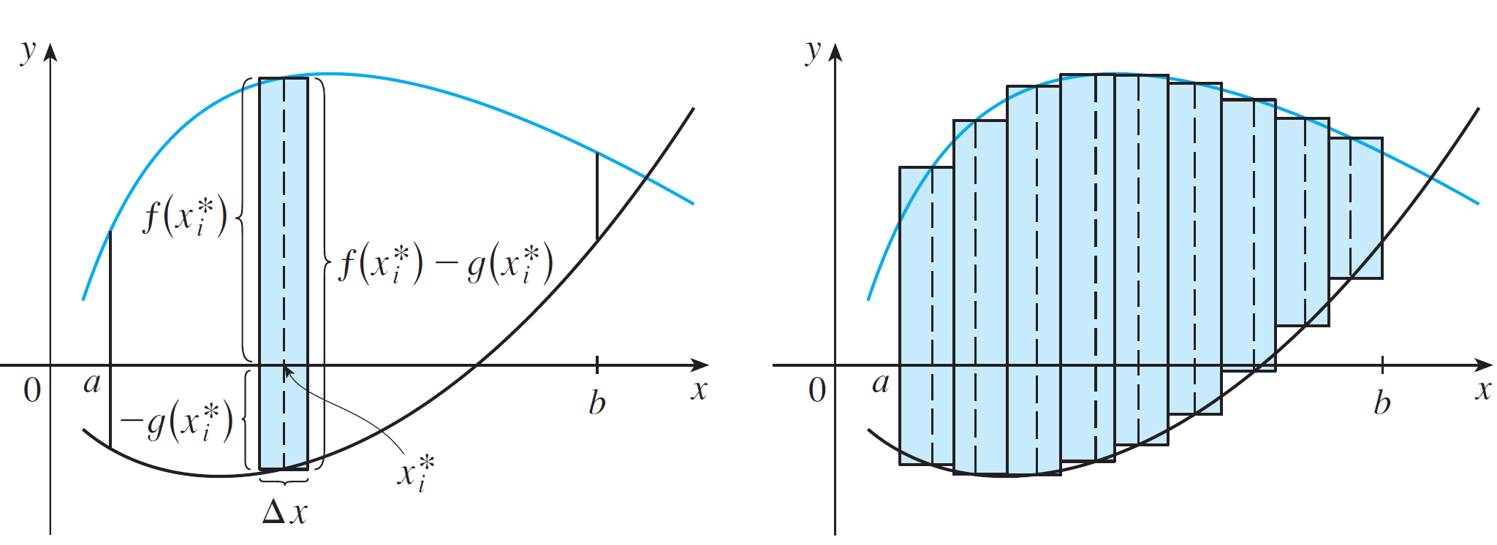
Areas between Curves
We divide S into n strips of equal width and then we approximate the i th strip by a rectangle with base Δx and height . (See Figure 2. If we like, we could take all of the sample points to be right endpoints, in which case
.)
(a) Typical rectangle
(b) Approximating rectangles
Figure 2

Slide 5
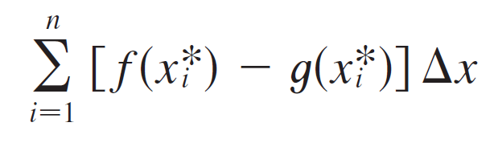

Areas between Curves
The Riemann sum
is therefore an approximation to what we intuitively think of as the area of S.
This approximation appears to become better and better
as .

Slide 6
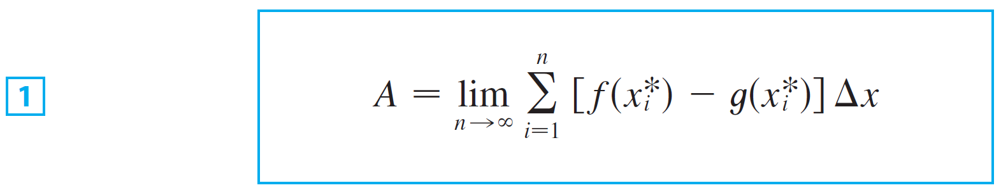

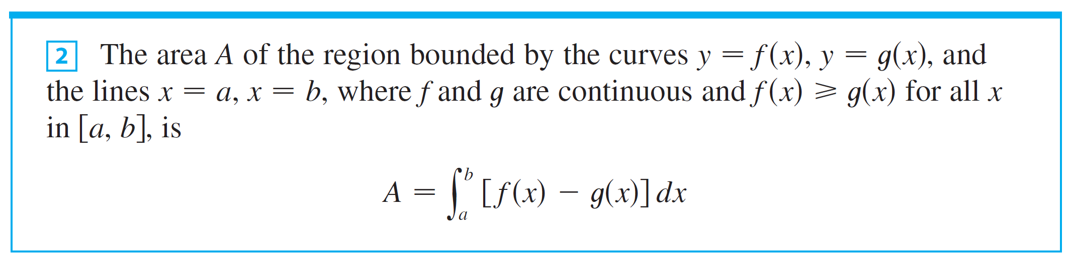
Areas between Curves
Therefore we define the area A of S as the limiting value of the sum of the areas of these approximating rectangles.
We recognize the limit in as the definite integral of f – g. Therefore we have the following formula for area.

Slide 7
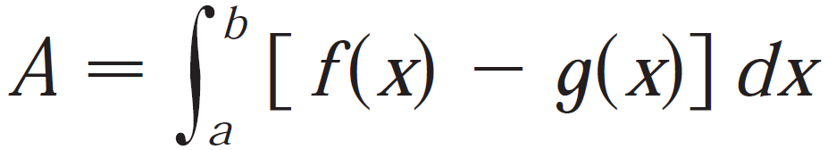
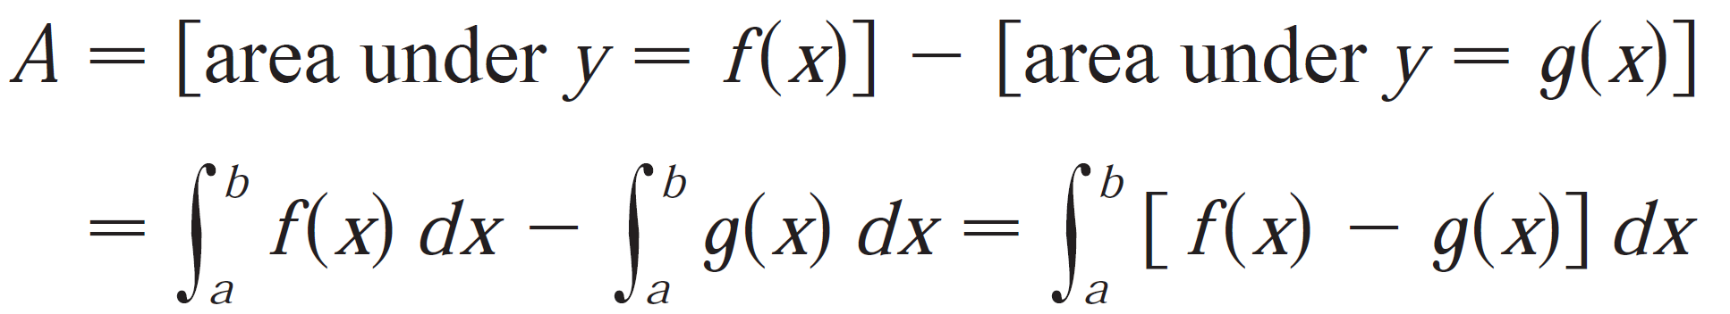
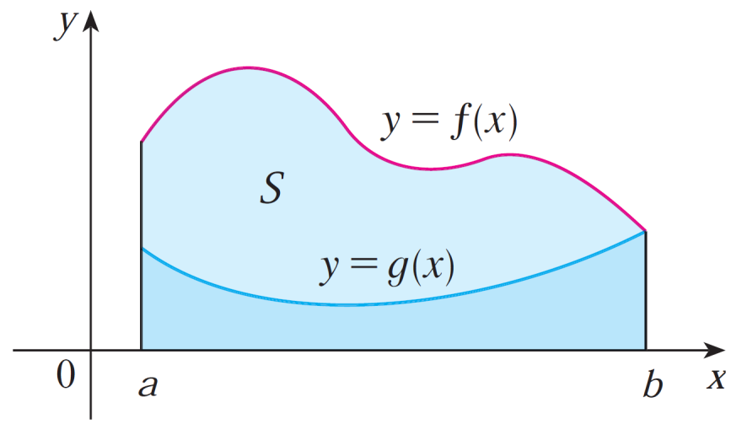
Areas between Curves
In the case where both f and g are positive, you can see from Figure 3 why we have
Figure 3

Slide 8
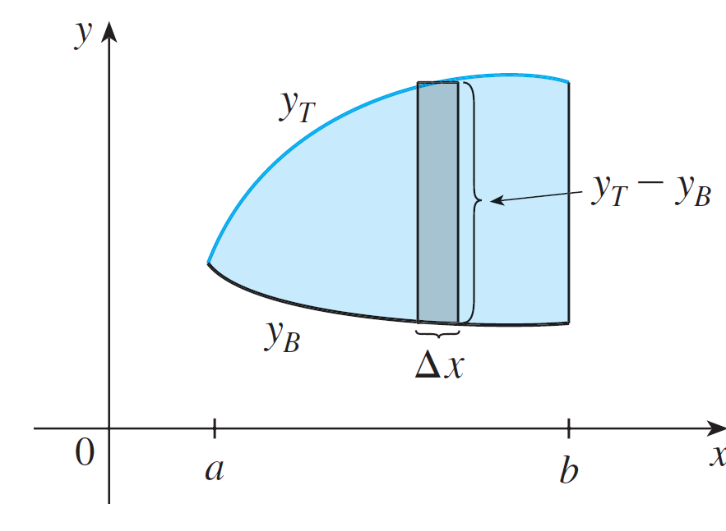
Areas between Curves
In general, when we set up an integral for an area, it’s helpful to sketch the region to identify the top curve y_{T}, the bottom curve y_{B}, and a typical approximating rectangle as in Figure 5.
Figure 5

Slide 9
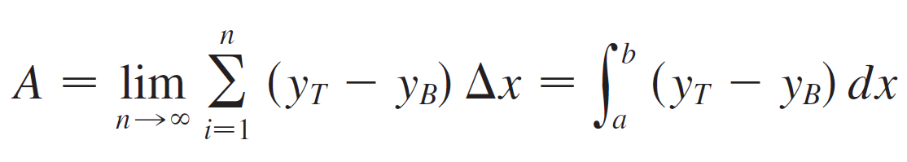
Areas between Curves
Then the area of a typical rectangle is (y_{T} – y_{B} ) Δx and the equation
summarizes the procedure of adding (in a limiting sense) the areas of all the typical rectangles.

Slide 10




Example 2
Find the area of the region enclosed by the parabolas
and .
Solution:
We first find the points of intersection of the parabolas by solving their equations simultaneously.
This gives , or .
Therefore 2x(x – 1) = 0, so x = 0 or 1.
The points of intersection are (0, 0) and (1, 1).

Slide 11
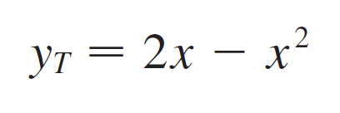

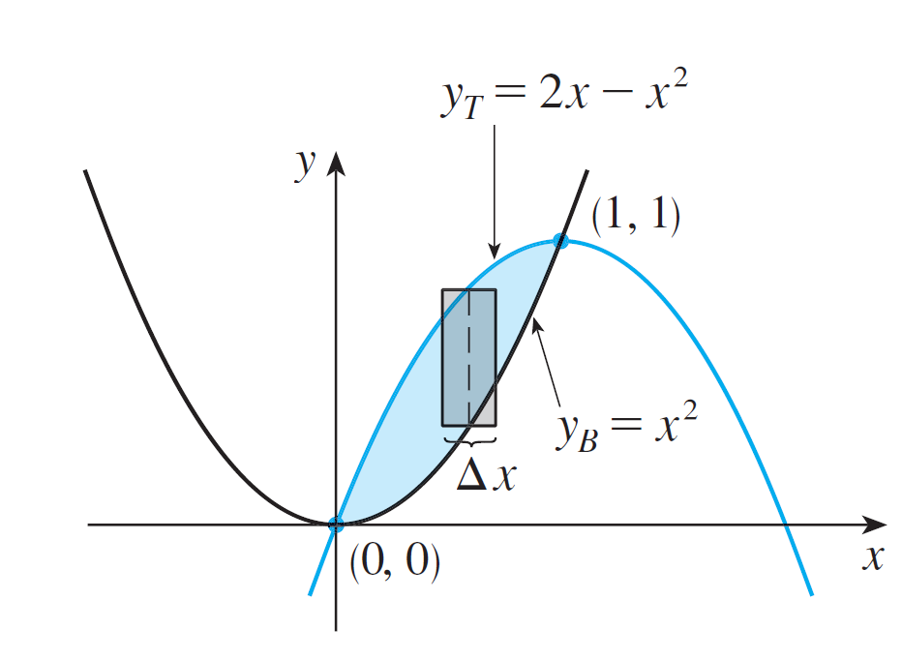
Example 2 – Solution
cont’d
We see from Figure 6 that the top and bottom boundaries are
and
Figure 6

Slide 12
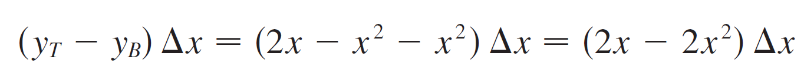
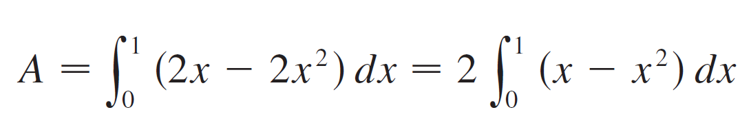
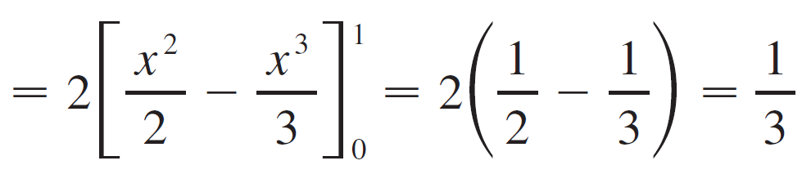
Example 2 – Solution
cont’d
The area of a typical rectangle is
and the region lies between x = 0 and x = 1.
So the total area is

Slide 13
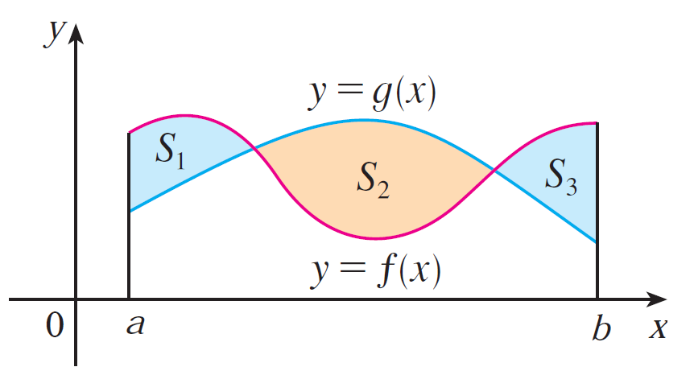
Areas between Curves
If we are asked to find the area between the curve y=f(x) and y=g(x) where f(x)>g(x) for some values of x, nut g(x)>f(x) for other values of x, then we split the region S into several sub-regions S1,S2,…with areas A1,A2,…as shown in Fig. 9
Figure 9

Slide 14
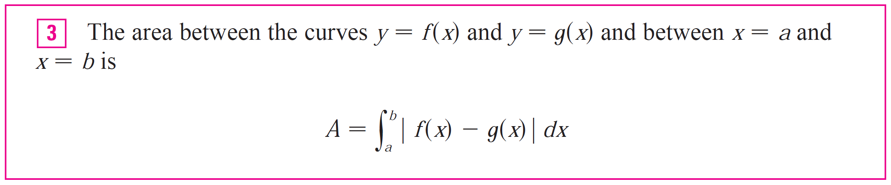
Areas between Curves

Slide 15

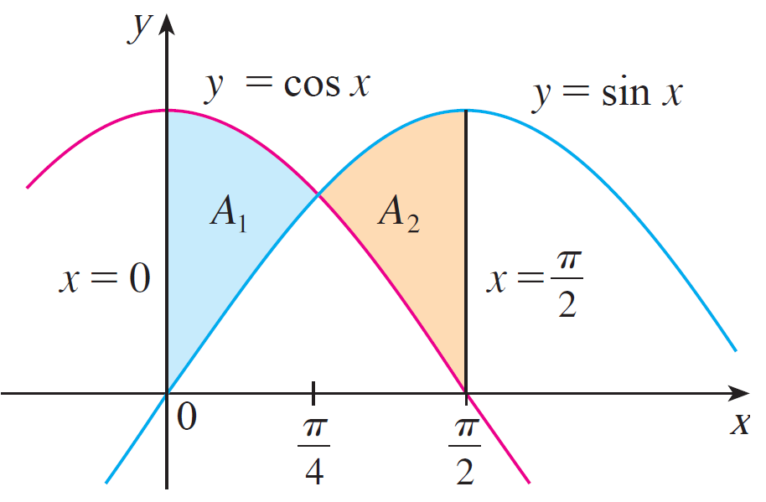
Example 3
Find the area of the region bounded by the curve y = sinx,
y = cosx, x = 0, and x = π/2.
Solution:
The points of intersection occur when sinx = cosx, that is, when x = π/4 (since ).

Slide 16




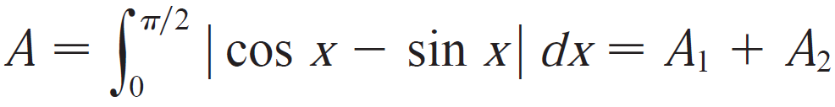
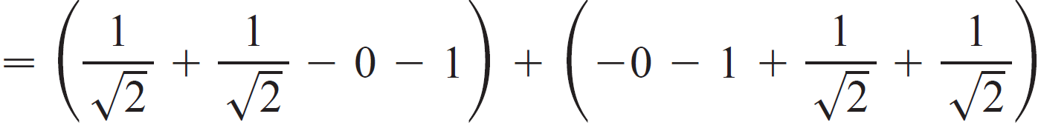

Example 3
Observe that when ,
but when
Therefore the required area is

Slide 17
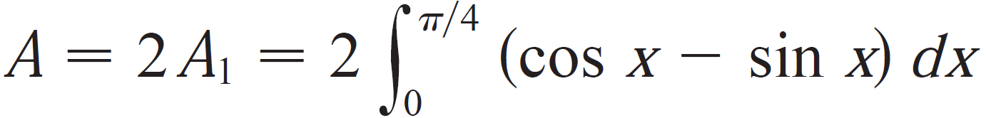
Example 3
In this particular example we could have saved some work by noticing the region is symmetric about x = π/4 and so

Slide 18
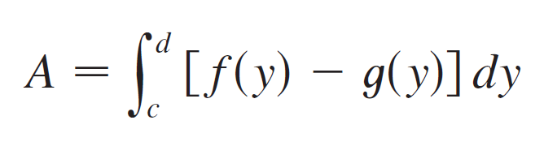
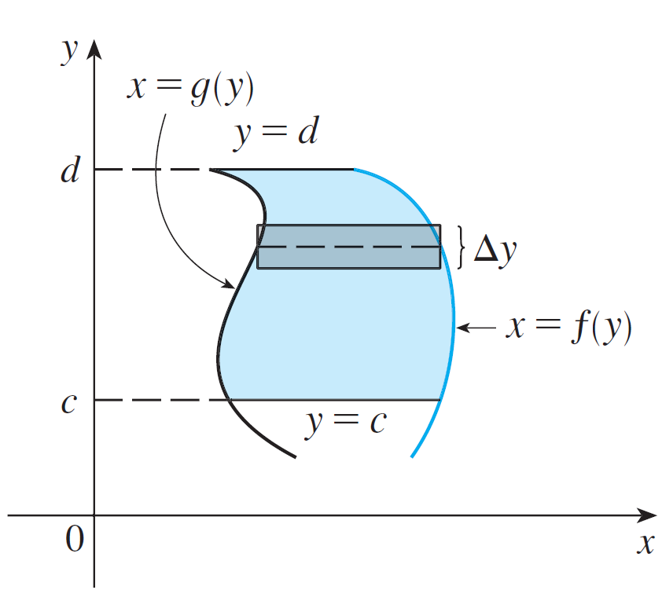
Areas between Curves
Some regions are best treated by regarding x as a function of y.
If a region is bounded by curves with equations x = f (y), x = g (y), y = c, and y = d, where f and g are continuous and f (y) ≥ g (y) for c ≤ y ≤ d (see Figure 8), then its area is
Figure 8

Slide 19
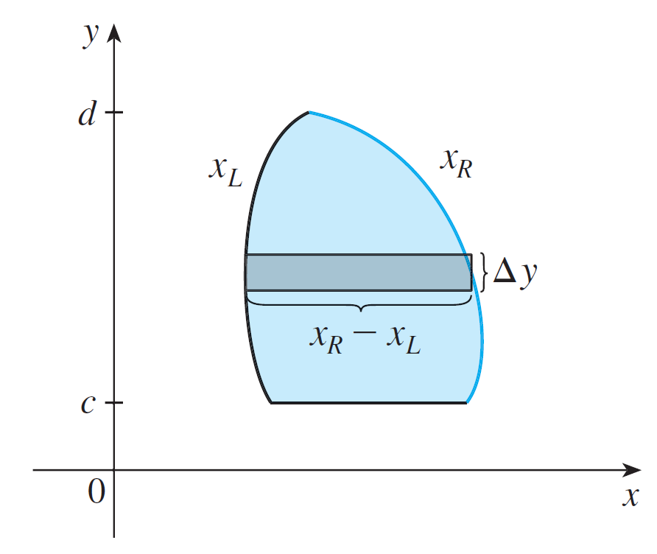
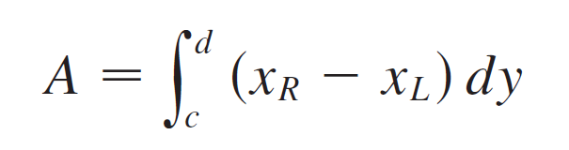
Areas between Curves
If we write x_{R} for the right boundary and x_{L} for the left boundary, then, as Figure 9 illustrates, we have
Here a typical approximating rectangle has dimensions x_{R} – x_{L} and Δy.
Figure 9

Slide 20


Example 4
Find the area enclosed by the line and the parabola .
Solution:
By solving the two equations we find that the points of intersection are (–1, –2) and (5, 4).

Slide 21
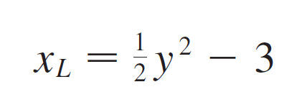

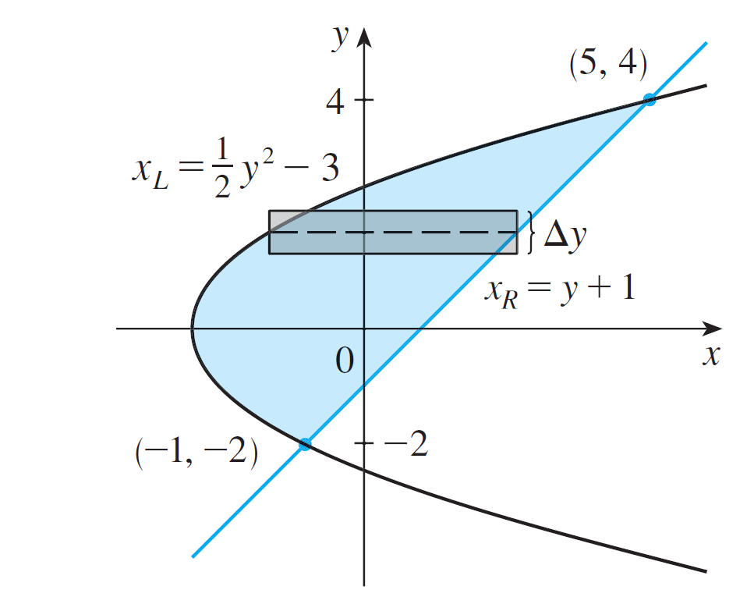
Example 4 – Solution
cont’d
We solve the equation of the parabola for x and notice from Figure 10 that the left and right boundary curves are
and
Figure 10

Slide 22
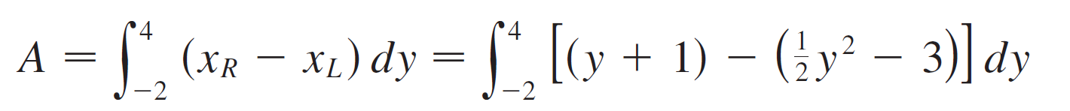
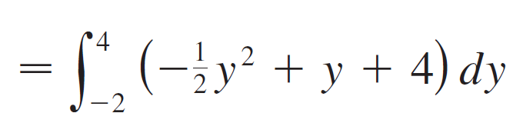
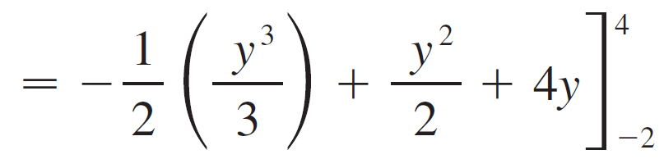


Example 4 – Solution
cont’d
We must integrate between the appropriate y-values, y = –2 and y = 4.
Thus

Slide 23
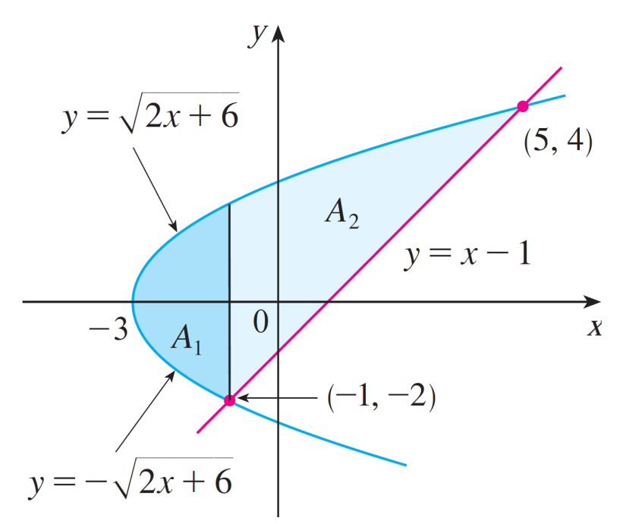
Example 4 – Solution
cont’d
Note: We could have found that the area in this example by integrating with respect to x instead of y, but the calculation is much more involved. It would have meant splitting the region in two and computing the areas labeled A1 and A2 in Figure 11. The method we used in example is much easier.
Figure 11

